Slide 1

Heritage Woods Secondary
Tuesday
October 21, 2025
“WE ARE KODIAKS”

Slide 2

Bell Schedule
Block 1 | 8:00 – 9:12
Block 2 | 9:16 – 10:28
FLEX | 10:28 – 10:57
Block 3 | 11:01 – 12:13
LUNCH | 12:13 – 12:53
Block 4 | 12:57 – 2:09
Block 5 | 2:13 – 3:25

Slide 3
No Flex BELL SCHEDULE
Monday, October 06, 2025
Block 1 | 8:00 – 9:12
Block 2 | 9:16 – 10:28
Block 3 | 10:32 – 11:44
LUNCH | 11:44 – 12:28
Block 4 | 12:32 – 1:44
Block 5 | 1:48 – 3:00

Slide 4
Alternate BELL SCHEDULE
Thursday, October 16, 2025
Block 1 | 8:00 – 9:12
Block 2 | 9:16 – 10:06
Block 3 | 10:10 – 11:00
LUNCH | 11:00 – 11:10
Block 4 | 11:15 – 12:05
Block 5 | 12:10 – 1:00

Slide 5
My Weekly Planner Flex Booking System
Follow the link below (also found on HWSS) website
Log in with your student number and password
Enter numbers only for your student number
Your default password is your student number
Set new password on first log in
Instructions to book your flex space were emailed to you
https://hwss.myweeklyplanner.net

Slide 6

FLEXpectations
Attend one of your 4 classes
The Grand Hall is for Grade 12’s only
The Library is a place for quiet work and is for Grade 11’s & 12’s only
Flex is less than 30 minutes, and you are to remain in one class
Flex is instructional time = Cell phones stored

Slide 7


Fragrance Free
Reminder to all that SD43 is Scent Aware, and as such the district is asking for cooperation towards a scent reduced environment.
All staff, students and visitors are strongly encouraged to avoid or reduce the use of fragranced products, and to replace them with unscented alternatives.
continuing

Slide 8
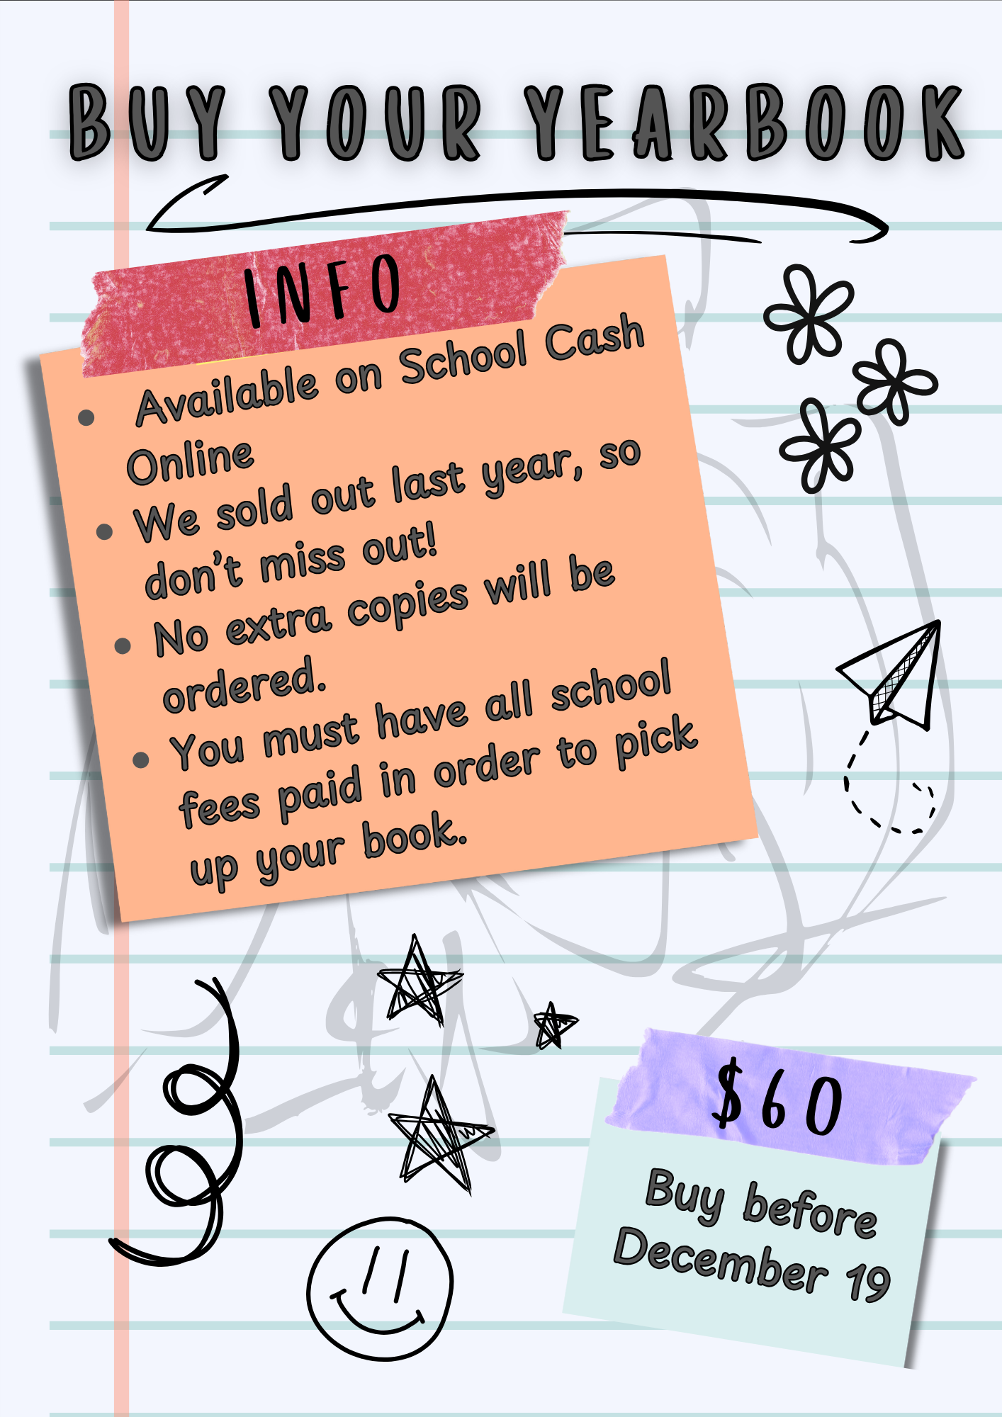
December

Slide 9
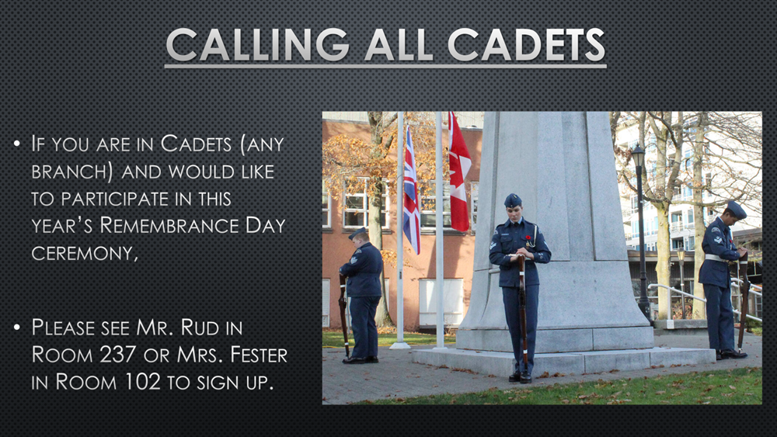
Oct 31
Oct 31

Slide 10


Hallowe’en Black-out POE-m Contest
Ha! English puns slay!
To enter:
Take a page from Edgar Allan Poe’s stories from English bulletin board (Bridge)
Black-out or conceal words, leaving only those words you want to keep to form a poem
Paint, collage, colour--be creative!
Prizes!
$50 or $25
Amazon Cards!
Submit by Tuesday, October 28 to your English teacher (or Mr. Smith in room 213)
Oct 28

Slide 11
Hallowe’en Black-out POE-m Contest
Rules:
Black out or conceal words from the photocopied text of Edgar Allan Poe’s stories, found on the English bulletin board
The words that remain visible become your POE-m!
Prize Categories: Best Poem, Most Artistic, Best ELL poem
Prizes: $50 and $25 Amazon gift cards
Submit by Tuesday, October 28 to your English teacher (or Mr. Smith in room 213)
Oct 28

Slide 12
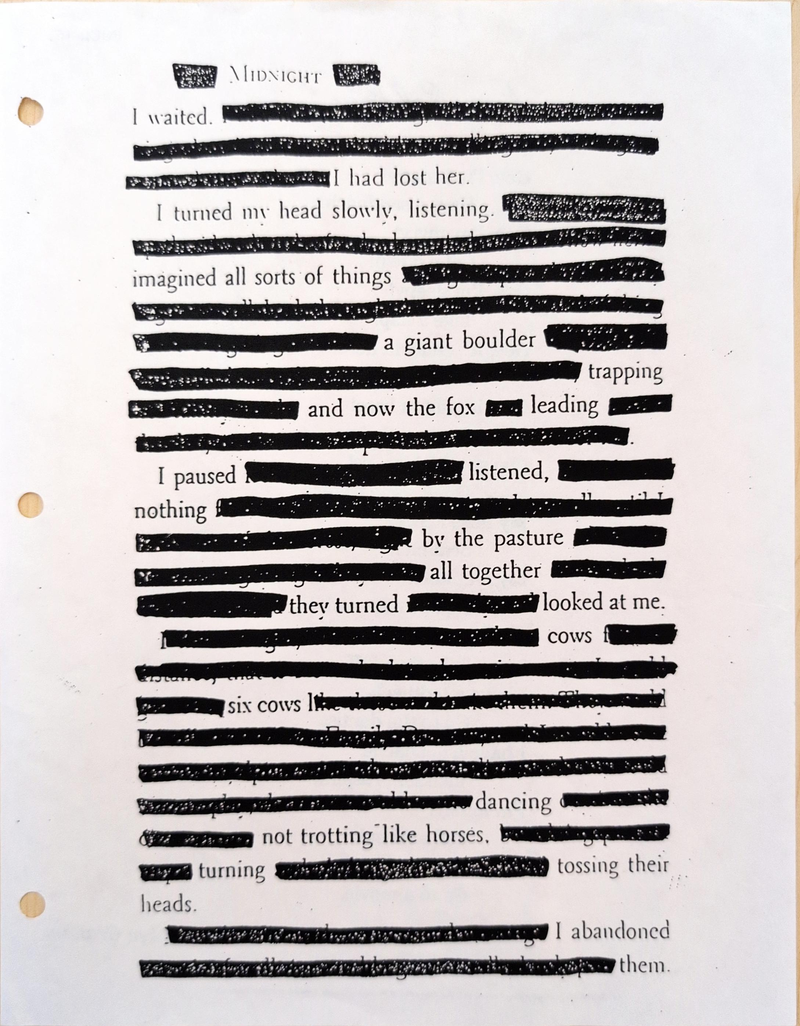
Hallowe’en Black-out POE-m Contest
Here’s a sample blackout poem, undecorated:
Can you beat this?
Submit by Tuesday, October 28 to your English teacher (or Mr. Smith in room 213)
Oct 28

Slide 13
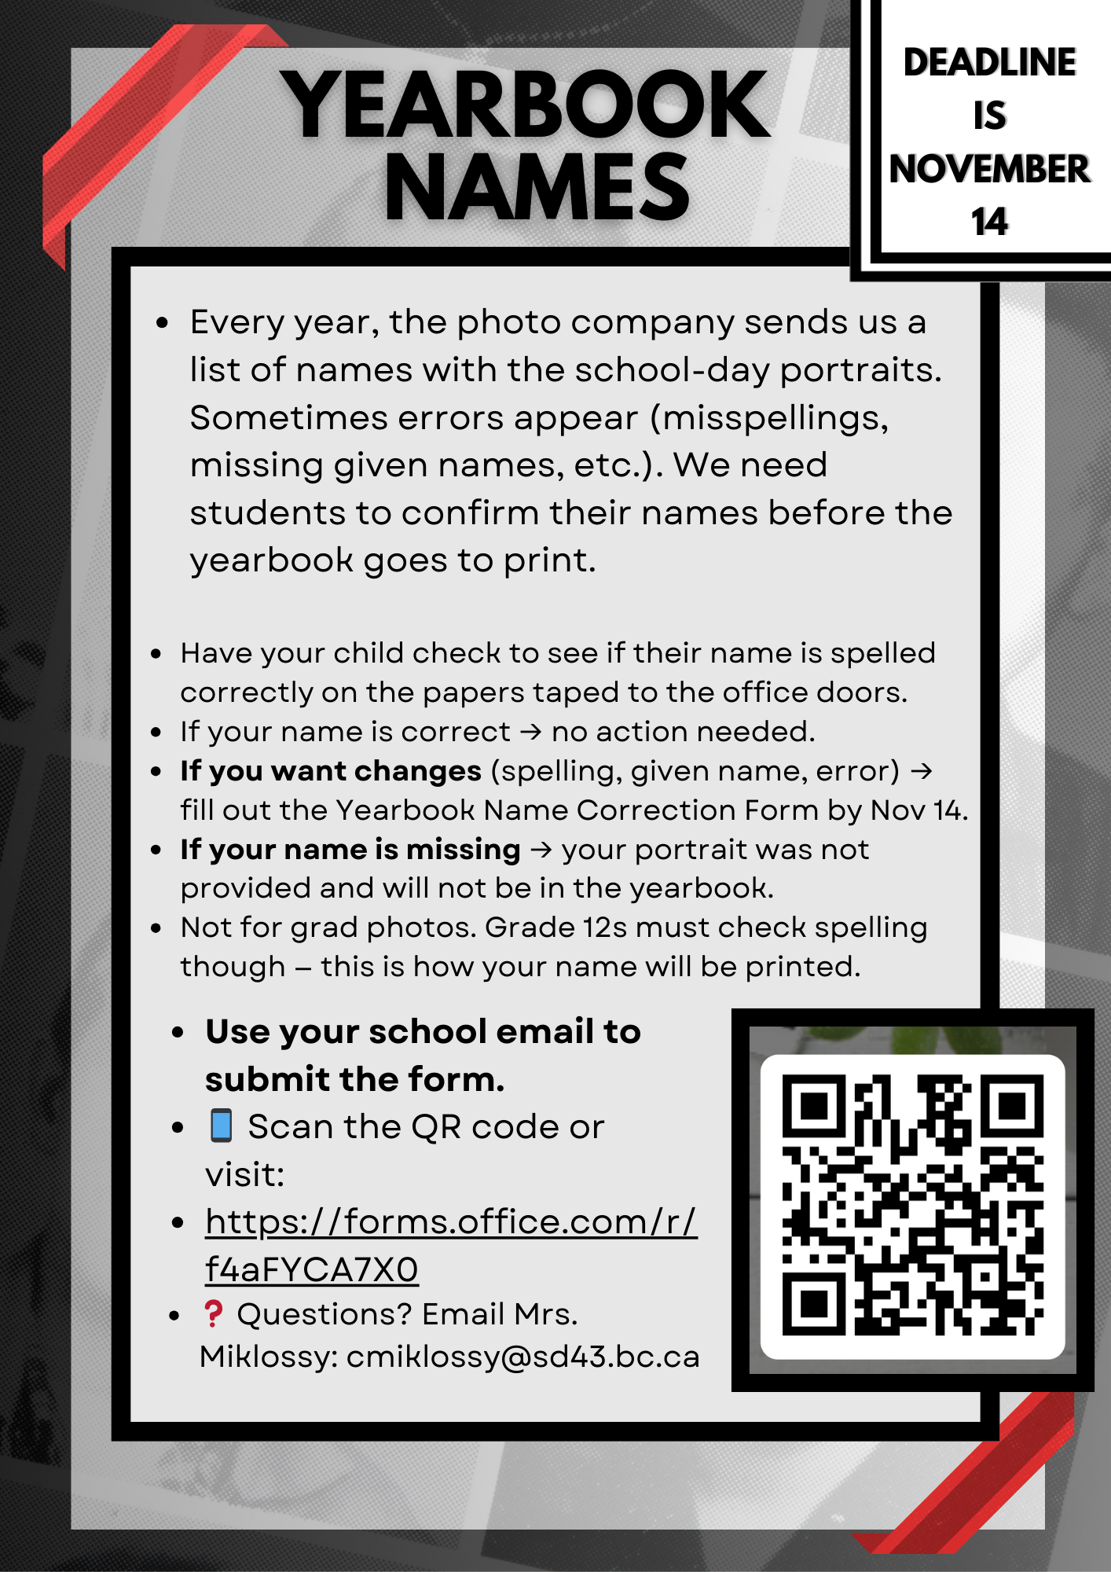
Nov 14

Slide 14
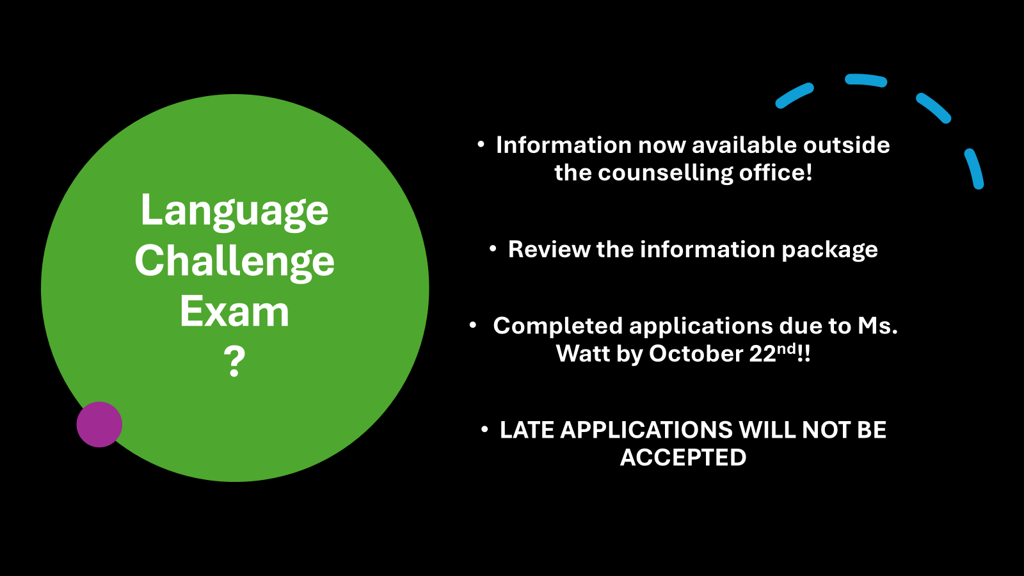
Oct 22

Slide 15
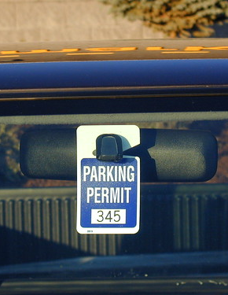
STUDENT PARKING PASSES
Reminder to students who are driving to school and parking in the school parking lots.
Please come to the HWSS main office to register your vehicle and receive a PARKING PASS to be displayed in vehicle. Usually hang from rear view mirror.
continuing

Slide 16


Thank you for your cooperation!
Please be respectful and refrain from parking in the handicap spots located at the back of the school. Unauthorized vehicles may be towed at the owner's expense.
continuing

Slide 17

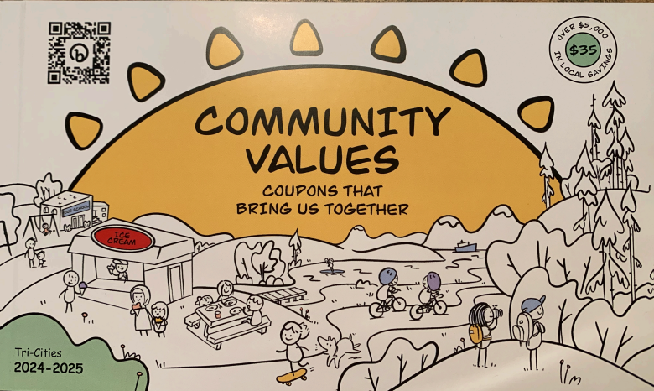
Coupon Books Get some great deals! Save Money!!
Purchased books may be
picked-up in the music
Office – Rm 102
- Bring receipt in
and start your savings!
Log into your Cash-On-Line
You can purchase as many books as you want.
Only $35 dollars.
Nov 3

Slide 18
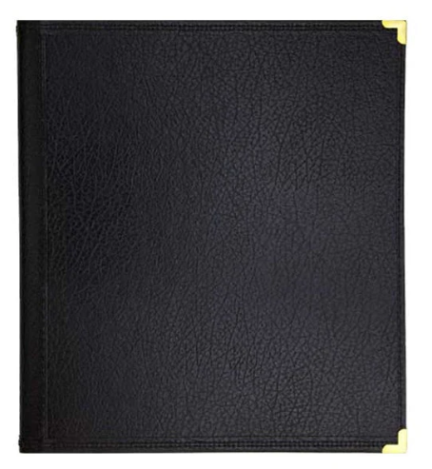
Music Folders have arrived!
If you ordered a music folder, please come and pick-up today at lunch in the music office!
Oct 23

Slide 19

HWSS Fall Concert
Admission by Donation
Wednesday, October 29, 2025, 7:00 P.M.
Under the Direction of:
Mrs. K. Fester and Mr. R. Esau
Featuring HWSS Concert Bands, Jazz Bands,
Concert Choir, Vocal Jazz and String Orchestra.
Oct 29

Slide 20

CLUBS

Slide 21
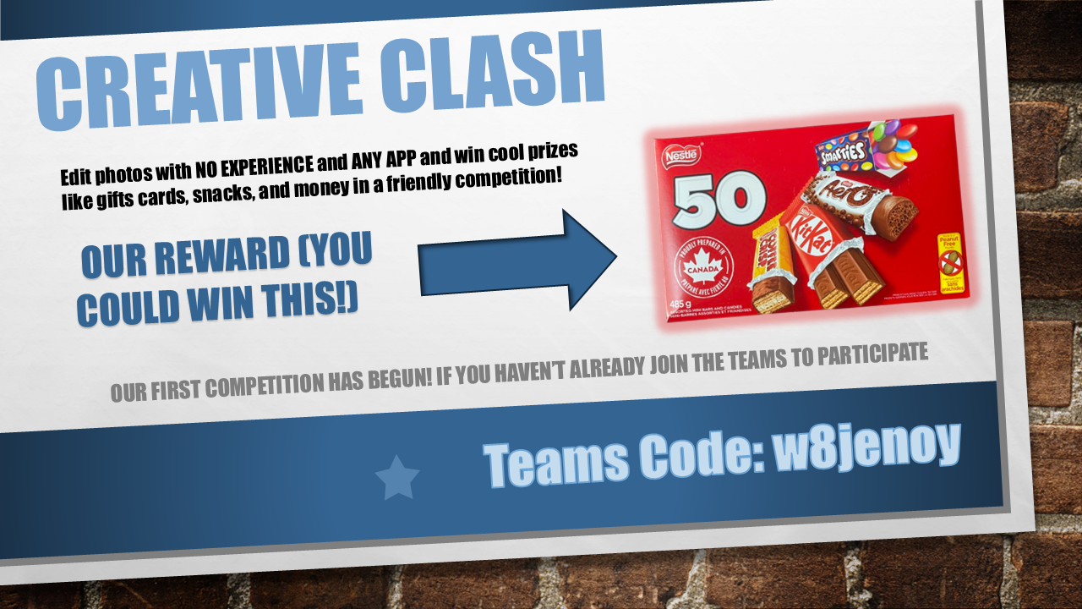
Oct 21

Slide 22

Oct 21

Slide 23

Oct 21

Slide 24

Oct 23

Slide 25

Oct 21

Slide 26
KODIAK
ATHLETICS

Slide 27

Upcoming Basketball at Heritage Woods
Friday Oct 24th
7-8:30 GR 9 Boys Tryout
8:30-10 SR Boys Tryout
2:30-4 Junior Boys Tryout
Sunday Oct 26th
10:30-12:30 Senior Boys Open Gym
12:30-2 Grade 9 Boys Tryouts
2-4 Junior Boys Tryouts
Oct 26

Slide 28

Oct 31

Slide 29
CAREER CENTER

Slide 30
Post-secondary info sessions
October 10 lunch Grand Hall
October 14 lunch Room 109
October 15 lunch Grand Hall
October 17 lunch Room 109
October 20 lunch Room 109
October 23 lunch Grand Hall
October 27 5pm Virtual
October 29 lunch Grand Hall
October 29 lunch Grand Hall
Douglas College Info Table
U Victoria info session
SFU Applied Sciences Info Table
SFU Beedie Info Session
Uvic Gustavson Business info session
U Guelph Info Table
UBC PharmaSci Info Session
Queen’s University Info Table
McMaster Info Table
Oct 29

Slide 31
COMMUNITY

Slide 32

The Royal LePage Shelter Foundation Night Light Walk is on Thursday October 23rd at Town Centre Park - West Lawn. We are looking for 12-20 energetic people to help direct participants around the 3k course and help out at the event site (which includes setting up and taking down tents, tables and chairs).
The timeframe for the volunteer positions is from 5:30PM - 9:00PM.
All volunteers will receive an exclusive Royal LePage® Shelter Foundation™ Night Light Walk™ red toque with built-in light and an LED glow bracelet.
Oct 23

Slide 33

Nov 12

Slide 34

Oct 22

Slide 35


Oct 22

